Slide 1
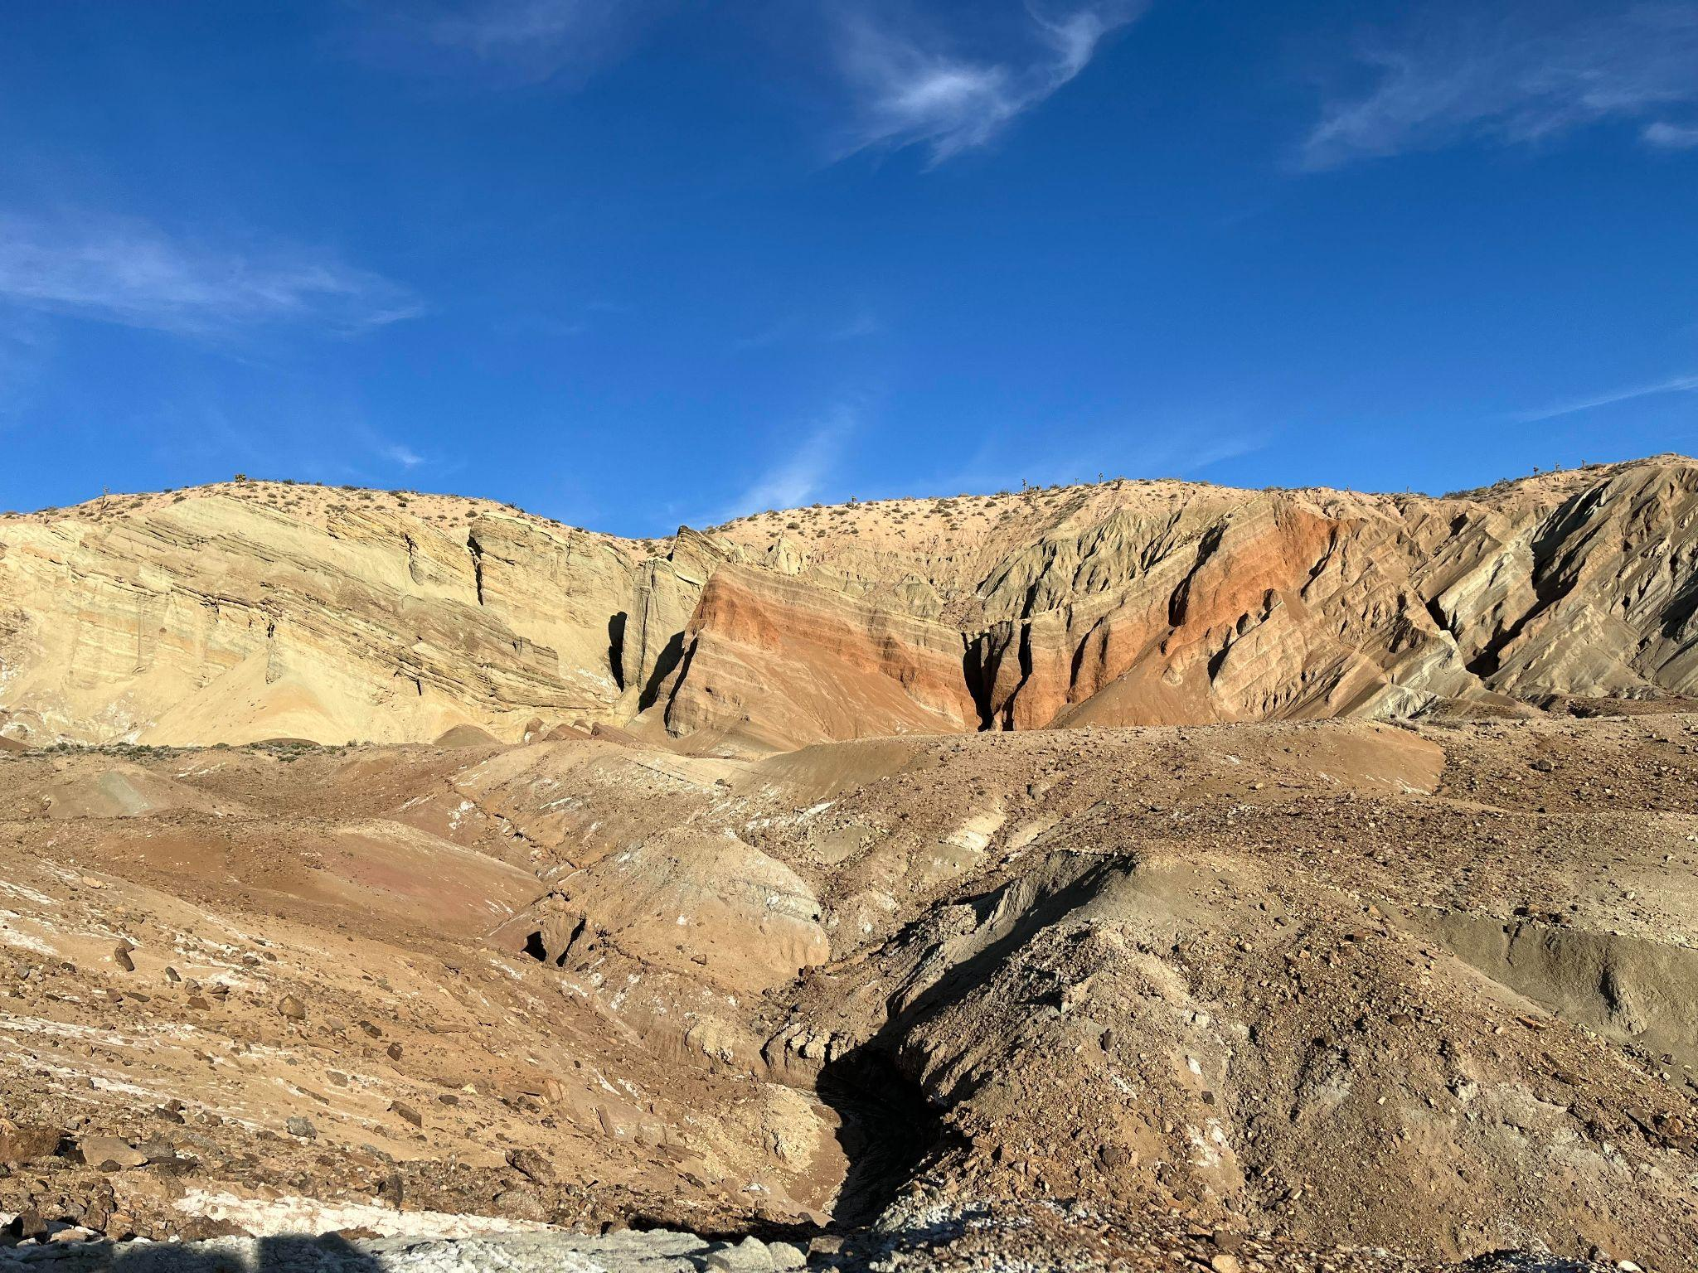
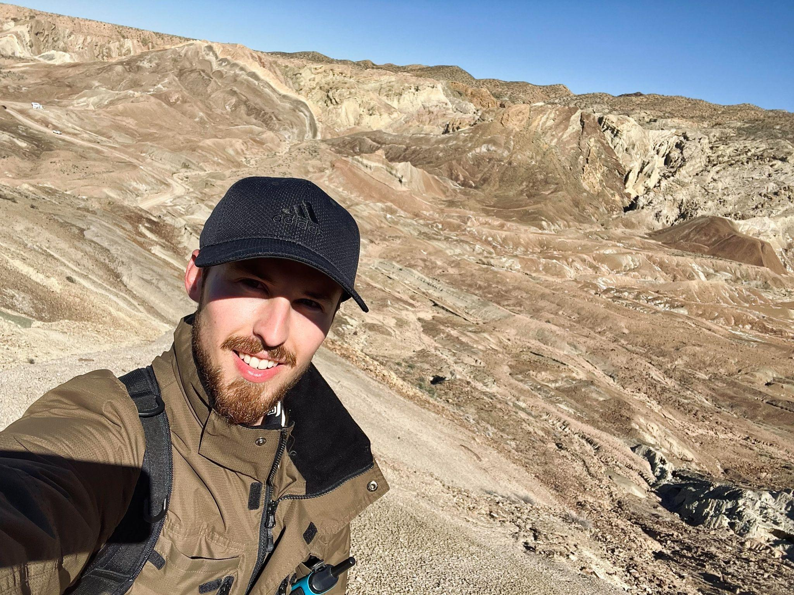
The Mojave Extensional Belt Dokka 1983, Dokka 1989
Ryan Parkyn

Slide 2
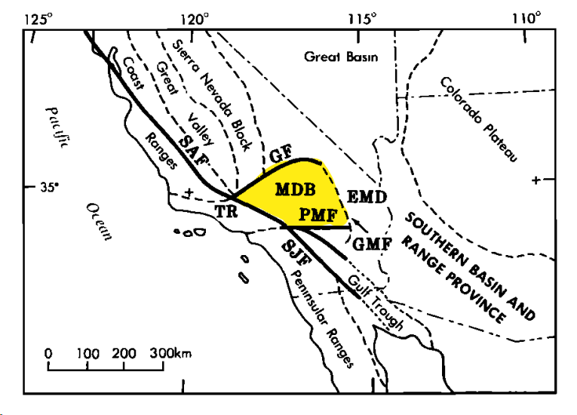
Where is the Mojave Desert Block?
MDB= Mojave Desert Block
EMD= Eastern Mojave Desert (geophysical boundary)
GF= Garlock Fault
PMF= Pine Mountain Fault
GMF= Granite Mountain Fault
TR= Transverse Ranges
SAF= San Andreas Fault
SJF= San Jacinto Fault

Slide 3
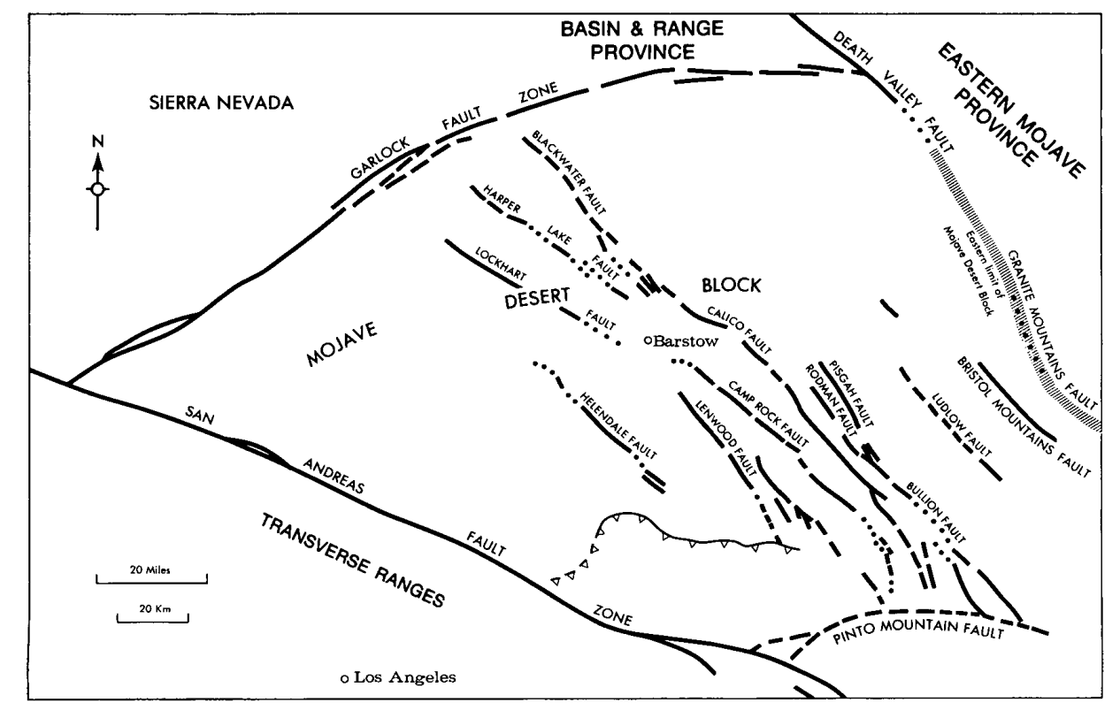
Mojave Extensional Belt
Problem (pre-Dokka 1983): previous scientists used only right lateral strike slip transtensional dogma to describe Mojave
New thesis(Dokka 1983 & 1989): Fault displacement + paleomagnetic data+ seismic data = full mojave displacement
Big Picture: Basin and range extension influenced the mojave provence before overprint of strike slip structures, rotated mojave block

Slide 4
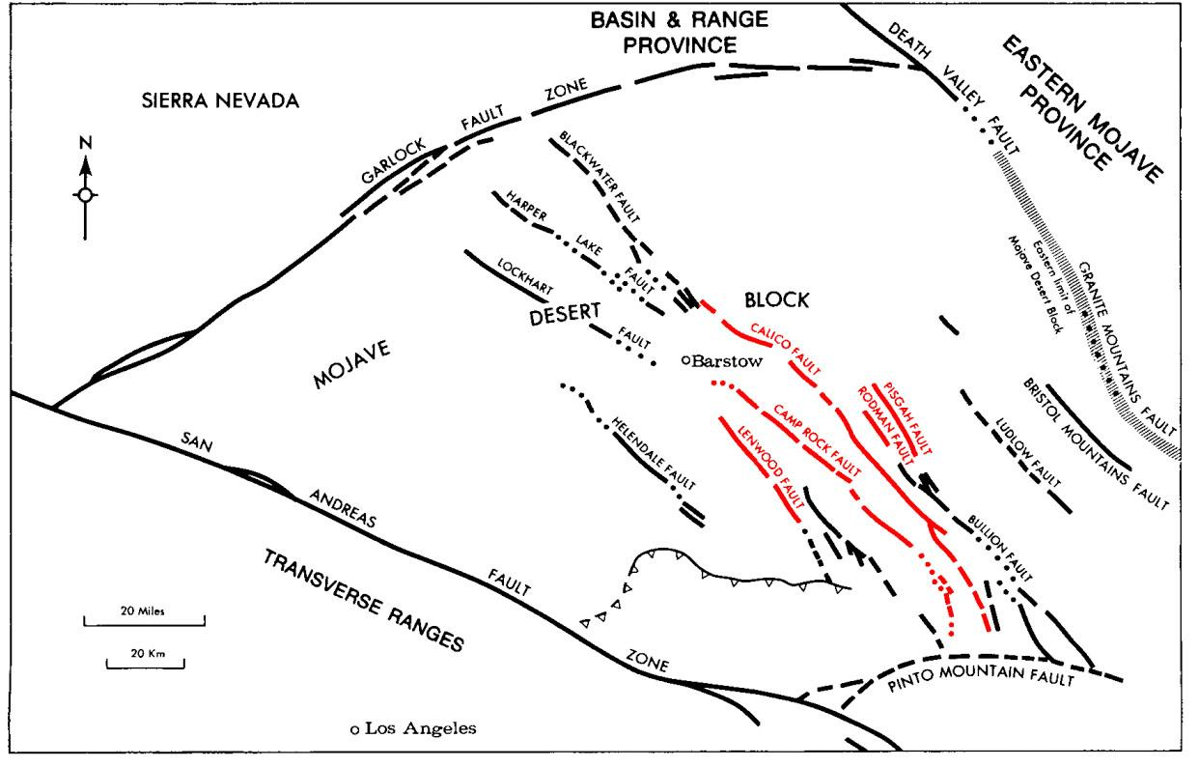
Dokka 1983: Mojave block fault slip
Lenwood = 1.5-3km
Camp Rock = 1.6-4.0 km
Calico = 8.2km
Rodman-Pisgah = 6.4-14.4km
Cumulative = 26.7-38.4km
Prev authors were incorrect about time and slip kinematics
Author = Developed after 20Ma

Slide 5
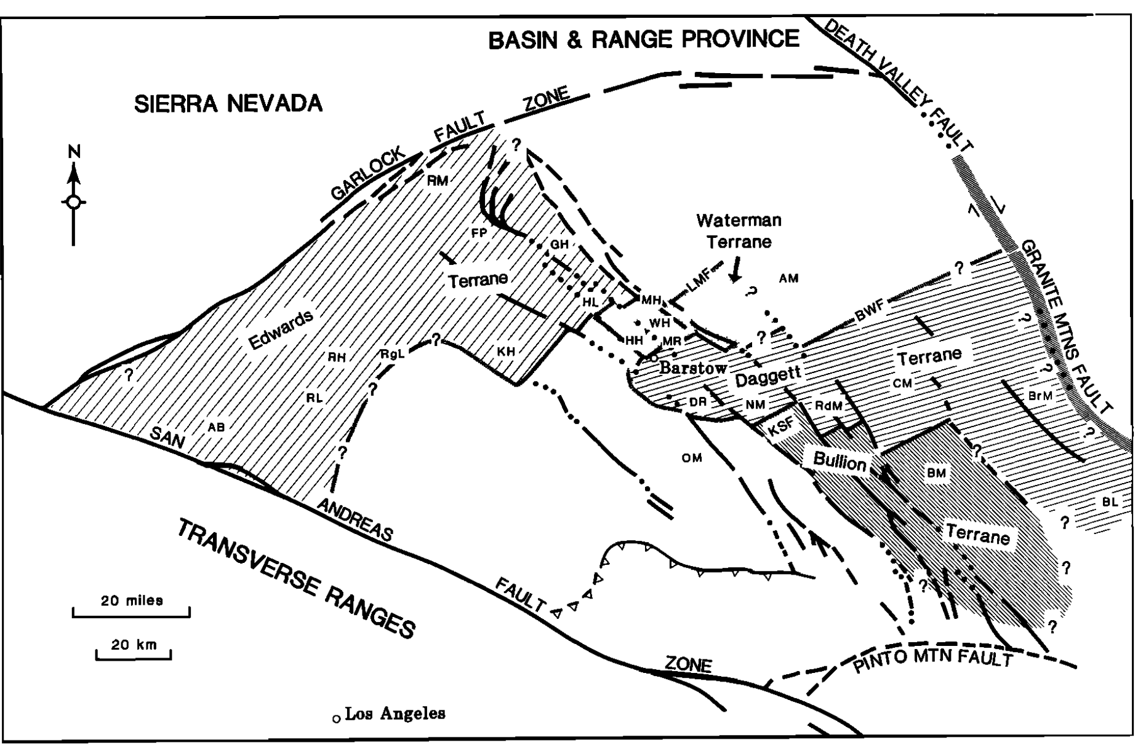
Dokka 1989: Paleomag, seismic, and displacement data defined 4 sub-blocks (domains)
4 Domains
Edwards
Waterman
Daggett
Bullion

Slide 6
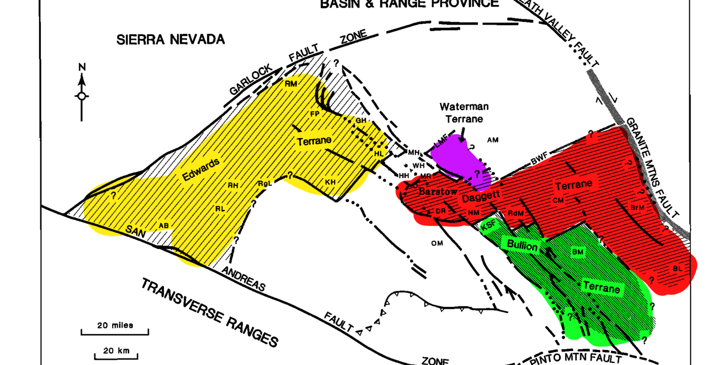
Notes:
Edwards Terrane
Titled upper plate blocks surrounded by quaternary sediments
Upper plate dipping NE 30-50, where strikes and dips change due to strain from the SAF
Detatchment evidence: seismic surveys paired with surface mapping (Harper Lake area)
Waterman Terrane
Good geo exposures
SW dipping miocene sed and volc resting unconformably on pre tertiary crystalline rocks
Contain Mylonites in the mitchell range and cut by a postdetatchment
Posttectonic tuffs in barstow frm = 19.3 ma illustrate around when basin half graben was filled
Rocks in footwall detachment are paleozoic shallow marine clastics, intruded by jurassic and cretaceous granites, with a mylonitic NE transport direction
Daggert Terrane
20-25Ma dip 40 SW in hanging wall of normal breakaway faults
Bullion Terrane
Upper plate miocene strata 30 NE in association with SW dipping high angle normal faults
Tilting is unique due to different dip angle related to the block that extended the least in Moajve

Slide 7
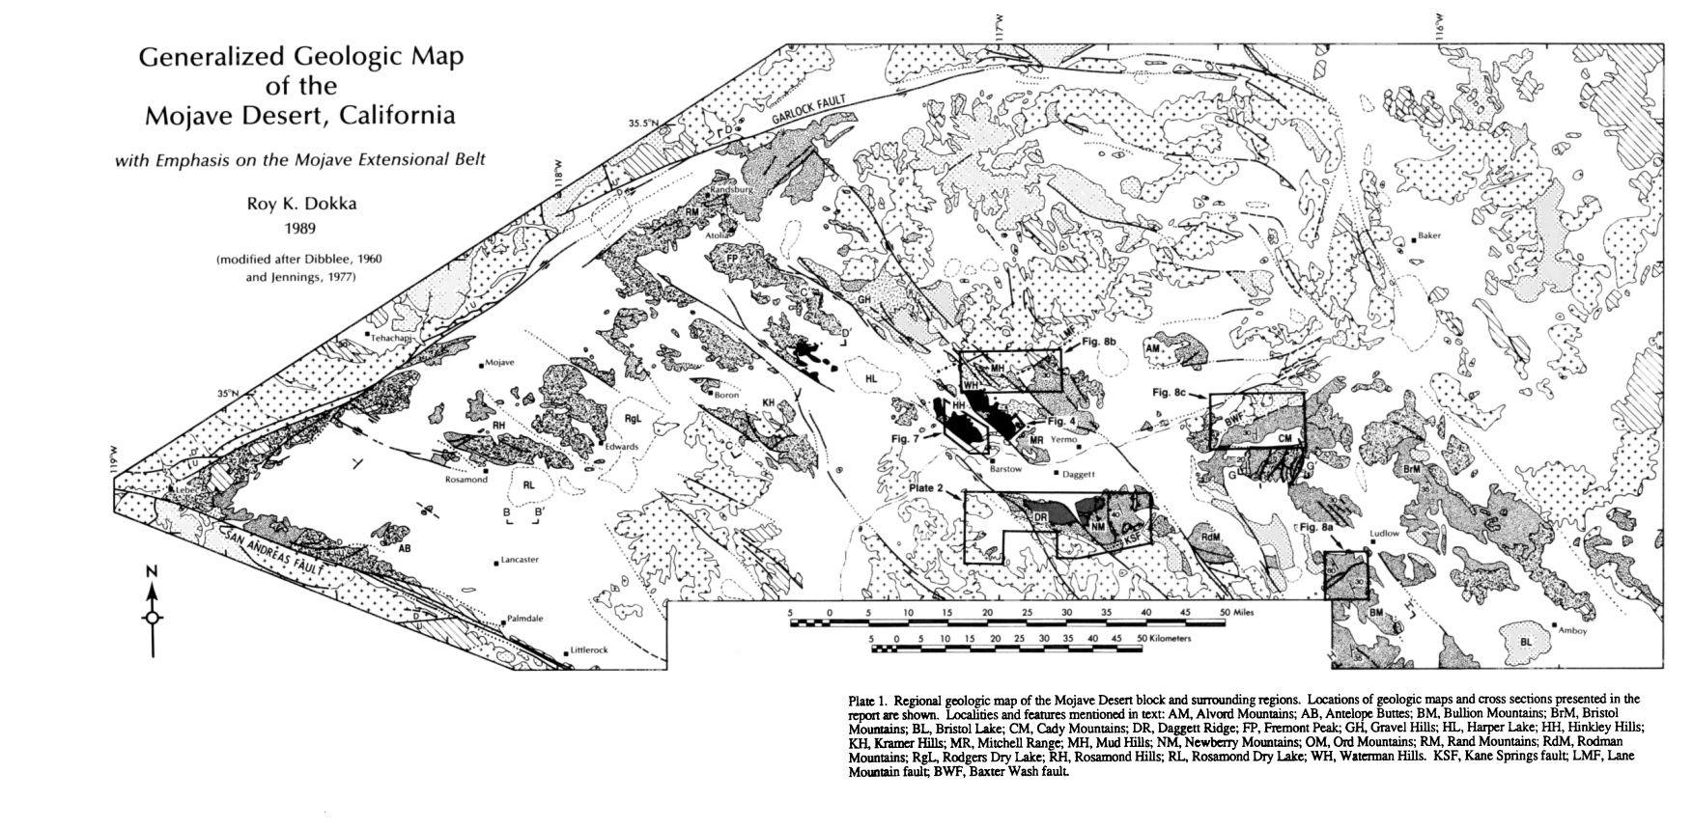
Plate 1

Slide 8
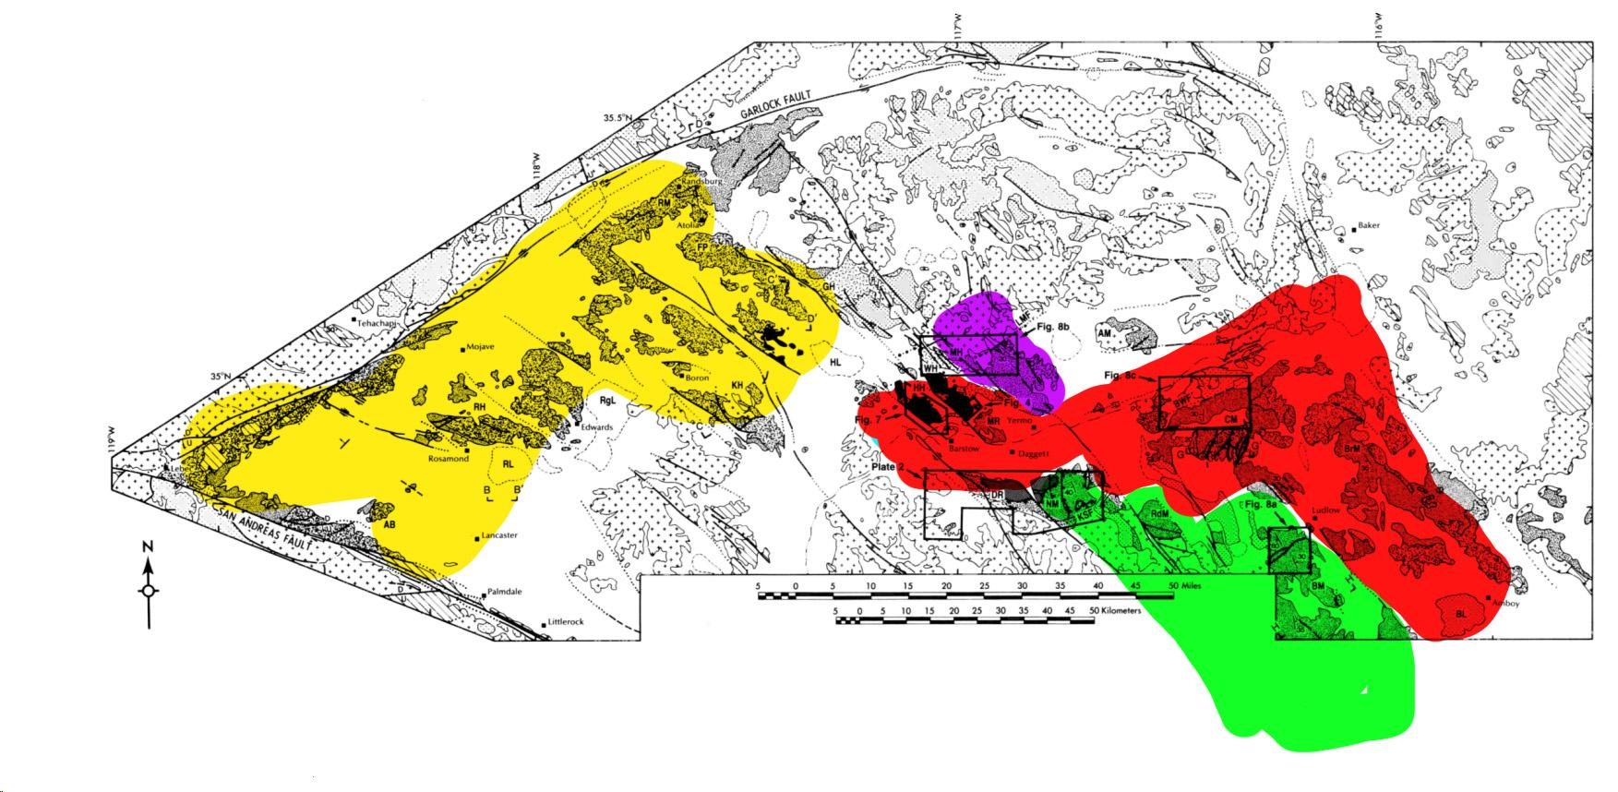
Simplified Block Diagram Overlayed onto Geologic Map
Waterman Terrane
DaggettTerrane
Edwards Terrane
Bullion Terrane
Plate 1

Slide 9
Simplified Block Diagram Overlayed onto Geologic Map
A
Waterman Terrane
DaggettTerrane
Edwards Terrane
Bullion Terrane
A’
Plate 1

Slide 10
Simplified Cross Section of the Mojave Extensional Belt
A
A’
A
A’
DaggettTerrane
Waterman Terrane
Edwards Terrane
Bullion Terrane

Slide 11
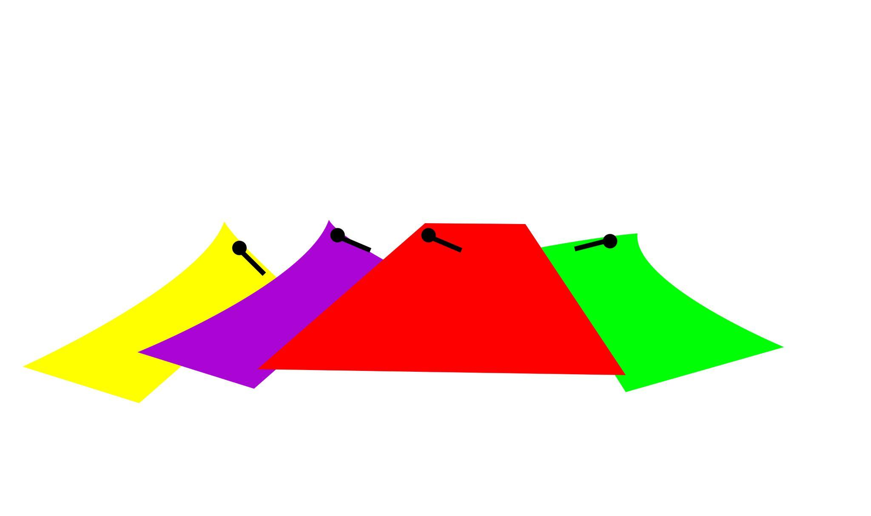
Simplified Cross Section of the Mojave Extensional Belt
A
A’
A
A’
DaggettTerrane
Waterman Terrane
Edwards Terrane
Bullion Terrane

Slide 12
Simplified Cross Section of the Mojave Extensional Belt
A
POST EXTENSION:
Bains half grabens filled (orange)
Lacustrine
Volcaniclastics
Breccias/Conglomerates
Overprinted by SAF
A’
A
A’
DaggettTerrane
Waterman Terrane
Edwards Terrane
Bullion Terrane

Slide 13
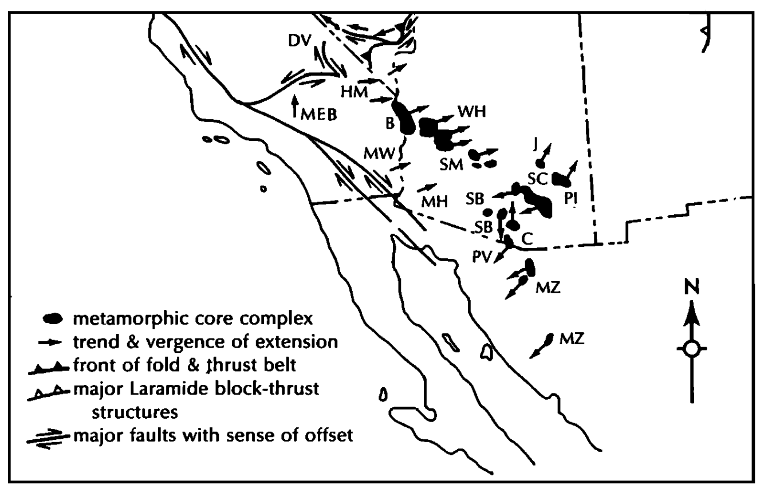
Southwestern Early Miocene Extension
Extension had N-S vergence (miocene)
CW rotation due to SAF (cenozoic)
Appears E trending (present)
Figure 11

Slide 14
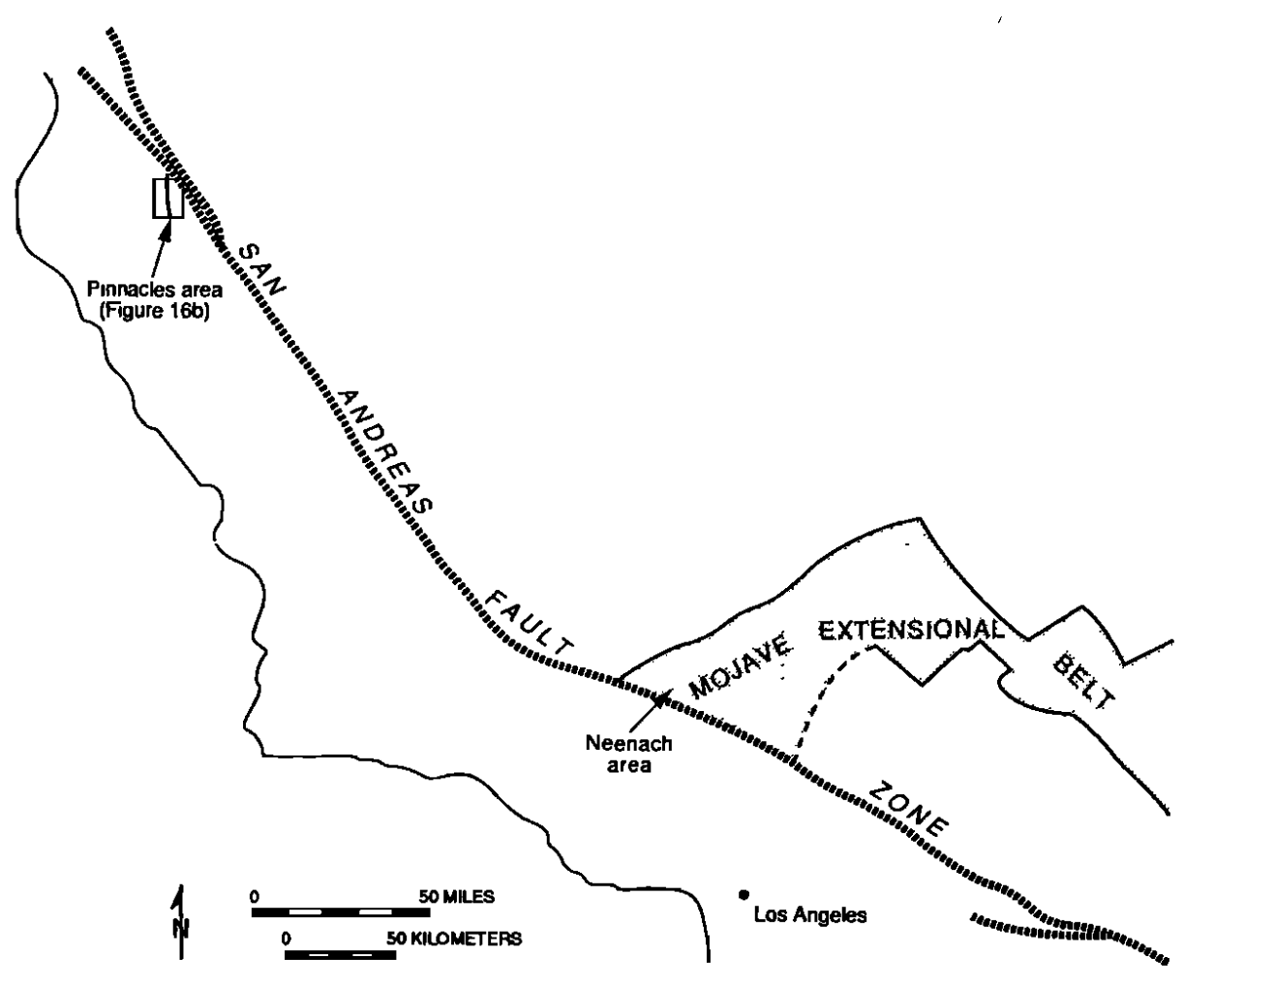
Post-miocene SAF Extension

Slide 15
